Slide 1

Data Sources/Consider
Comprehensive Needs Assessment
School Improvement Plan
District Climate Survey (Title I Items)
PM3 Data/Connection to Phase III
Notes:
Calling out some data sources to get them started…

Slide 2

All About Title I
Title I is the largest federal assistance program for our nation’s schools.
The program serves 85 schools in Pinellas County including eligible students in 36 non-public schools.
Notes:
Highlight the Title I Program here in Pinellas County.

Slide 3


Title I Annual Parent Meeting
Boca Ciega High School
Jennifer Gil
September 11, 2023
6 p.m.
Student Activities Room
Notes:
Evidence: Upload completed presentation and recorded feedback as part of the evidence to support the Annual Meeting Materials. Do not forget the sign-in sheets, and survey/feedback that you receive throughout the meeting.

Slide 4

Title I Funding Process
2. Florida Department of Education
1. Federal Government
3. Pinellas County Schools
4. Boca Ciega High School
Notes:
The Florida Department of Education receives funds from the federal government. Districts receive Title I funds from Department of Education, and the school district distributes these funds to schools based on the percentage of children eligible for free/reduced price lunch; however, students do not have to be from low-income families to receive help.

Slide 5
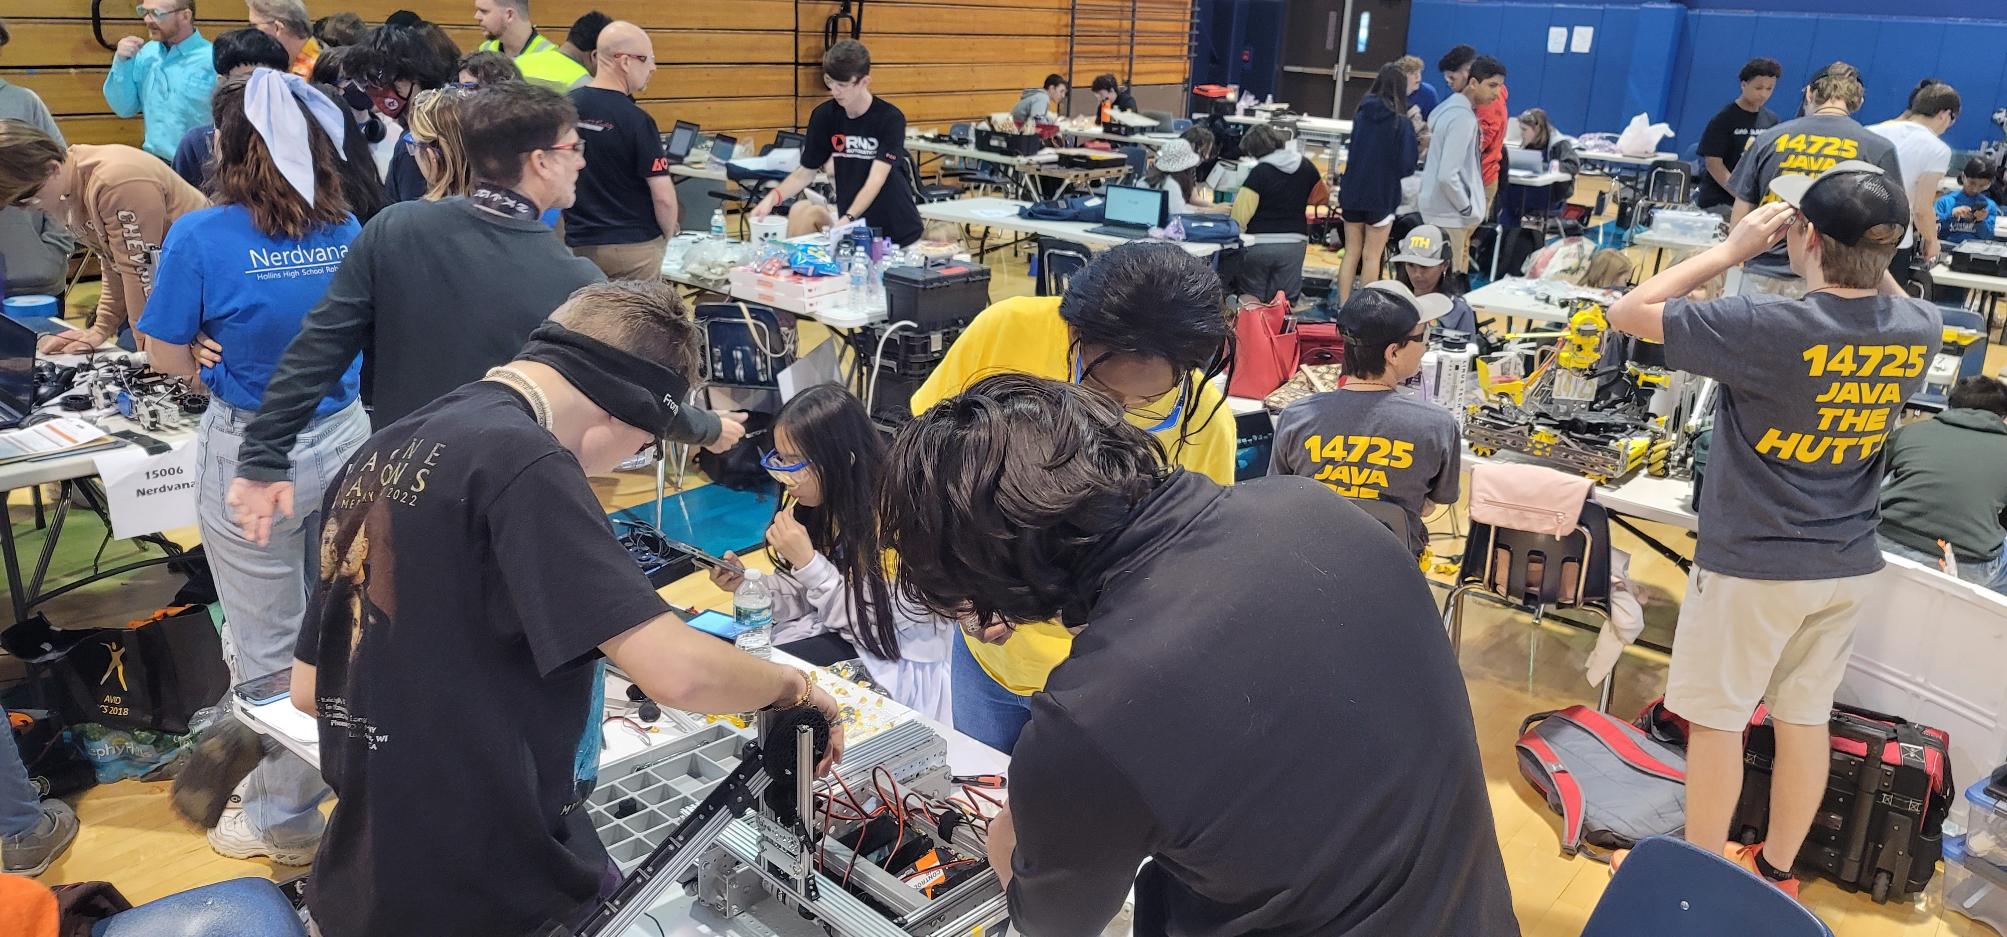

Title I
Supplemental Resources
Definition: provided in addition to what is already present or available to complete or enhance it.
https://languages.oup.com/
Notes:
Title I is supplemental federal funding that provides e
Definition: provided in addition to what is already present or available to complete or enhance it extra academic support and learning opportunities for economically disadvantaged students.

Slide 6
Title I Schoolwide Planning and Input
First
Second
Last
Seek Input from school, family, and community members determine how Title I funds are used based on a needs assessment.
Please attend online or in-person meetings/trainings and complete surveys to provide input on Title I funding.
All Title I schools must document that parents are involved in the schoolwide planning process.
Notes:
Evidence for input – input from school can be a survey or notes, which include quotes related to what was shared as feedback AND how this input will be used to inform the PFEP and future engagement activities.
Evidence of Attendance – please include attendance of DIVERSE stakeholder group/s.

Slide 7

Title I Schoolwide Budget
Boca Ciega High School is provided $346,850 to pay for supplemental resources and programs for increased student achievement.
Personnel – $296,084.32
  Kelvin Smarwt, AVID
  Lucas Corson, AVID and Math
  Rachael Holman, MTSS Coach
  Morgan Milavickas, College & Career Counselor, PSAT/SAT/AP/ACT/ASVAB test coordinator
  Plant Operations

Slide 8
Title I Schoolwide Budget
Boca Ciega High School is provided $346,850 to pay for supplemental resources and programs for increased student achievement.
Professional Development - $8,727.84
  June site-based training
Contracted Services – $5,188.22
  Collaborative planning – during school year & summer
  Summer Work – cohort management & enrichment programs
Supplemental Instructional Materials, Resources and Technology Supports - $21,849.62
Field Trips - $15,000

Slide 9

Parent’s Right to Know
As a parent of a student attending a Pinellas County School Public School, you have the right to…
Be
Be provided information on your child’s level of achievement on assessments in Reading/Language Arts, Writing, Mathematics, and Science.
Request and receive information on the qualifications of your child’s teacher and supplemental personnel working with your child.
Be
Be notified of non-highly qualified or out-of-field teachers at the school.
Be
Be informed if your child is taught by a non-highly qualified teacher for four or more consecutive weeks.

Slide 10
Working Together for Student Success
School
School Improvement Plan (SIP)
Title
Title I Schoolwide Plan
Parent
Parent and Family Engagement Plan
School
School-Parent-Student Compact
Notes:
As a Title I parent you have the right to be involved in the development of the following plans and documents for our school which can be found on our website (insert website) to view as well as in the Parent Station located (insert location here).
Our school’s Title I Parent Station is located (insert location or photo of Title I Parent Station (front office and on the webpage). Please include photo as part of the evidence monitoring.
You will find a copy of our School Improvement Plan, Title I Schoolwide Plan, School’s PFEP, the School District’s PFEP, Parent’s Right to Know Memo, Upcoming Events, Compact, (insert other documents at your station)
School Improvement Plan (SIP)
Parent and Family Engagement Plan
Title I Schoolwide Plan
School-Parent-Student Compact

Slide 11

Parent-School-Student Compact
The purpose of the compact is to foster student achievement. By signing the Parent-School-Student Compact, Boca Ciega High School, teachers, staff, parents and students agree to work together to share the responsibility of helping students meet or exceed state, district and school academic goals.
The Parent-School-Student Compact is updated every year to include parent, student, teacher, and staff input. Parent, student, teacher and staff comments are welcome at any time during the year.
Please review and sign your child’s Compact.
Our goal is to receive 100% signed compacts!
Notes:
At the elementary level, school compacts are used as a progress monitoring tool through the year during parent teacher conferences.

Slide 12
Sample School Compact
BCHS Parent / Guardian Agreement: I want my child to reach his / her full academic potential; therefore, I will do the following to support my child’s learning:
Maintain on-going communication with my student’s school
Attend school events when available
Ensure my student comes to school on time each day by 7:10 a.m. prepared and ready to learn
Review my student’s academic progress with my student at least weekly using FOCUS
Encourage educational reading and completion of homework
Respect all others at all times
Review the school wide binder contents with my student on a weekly basis
Parent / Guardian Signature ___________ Date ______
Notes:
Please insert the an example of your updated school compact. Highlight any things that unique to your school’s compact.

Slide 13
Sample School Compact
BCHS Student Agreement: It is important that I do the best that I can; therefore, I will do the following:
Attend all classes on time each day on time prepared and ready to learn
Believe in my ability to learn and engage in the educational process
Work to the best of my ability
Respect all others at all times
Take responsibility for regular communication with my parent/guardian and school
Maintain an organized school binder system for all of my classes and review with my parent weekly
Student Signature __________________________ Date _______
Notes:
Please insert the an example of your updated school compact. Highlight any things that unique to your school’s compact.

Slide 14
Sample School Compact
BCHS School Agreement: The entire school staff will share the responsibility for improved student achievement; therefore, we will do the following:
Increase consistency and timeliness of communication with our students and families through FOCUS, Canvas, BCHS website, and/or email
Provide opportunities for parents to participate in their child’s school activities
Provide an environment conducive to learning
Respect others at all times
Build and foster supportive and positive relations with all students and their families
Administrator/Staff Signature _____________ Date ________
Notes:
Please insert the an example of your updated school compact. Highlight any things that unique to your school’s compact.

Slide 15
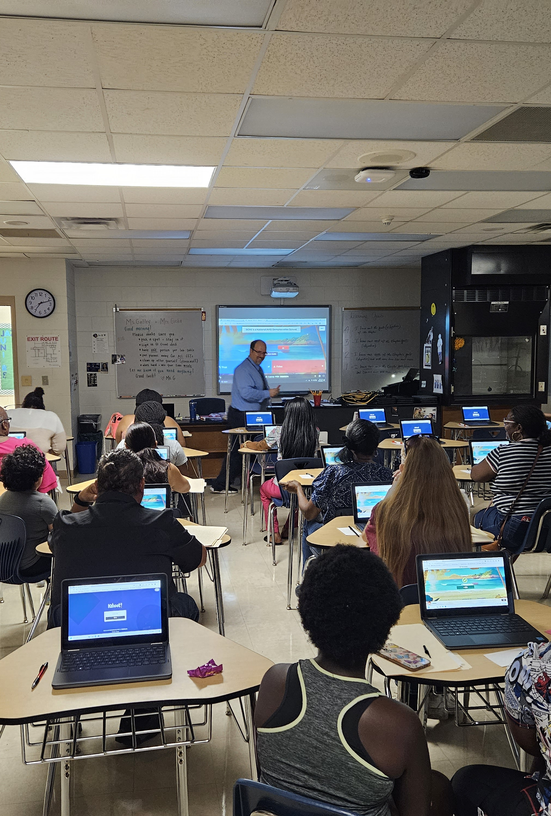
Parent and Family Engagement Plan (PFEP)
July 28th – Freshmen Family Fun Night
August 3rd – New Student Orientation
August 22nd – Open House
August 31st – Senior Parent Seminar
2nd Monday of the month – SAC
2nd Wednesday and Thursday of the month – Fundamental Parent Meeting
TBA – Off-Track Senior Meeting
TBA – Underclassmen Parent Seminar
March – Freshmen Registration Night
Notes:
Provide information on the specific committees that parents can be involved. Include the purpose, date and time of meetings.
Explain the PFEP and its purpose.
Consider the evidence related Title I Crate, Sample of Evidence,

Slide 16
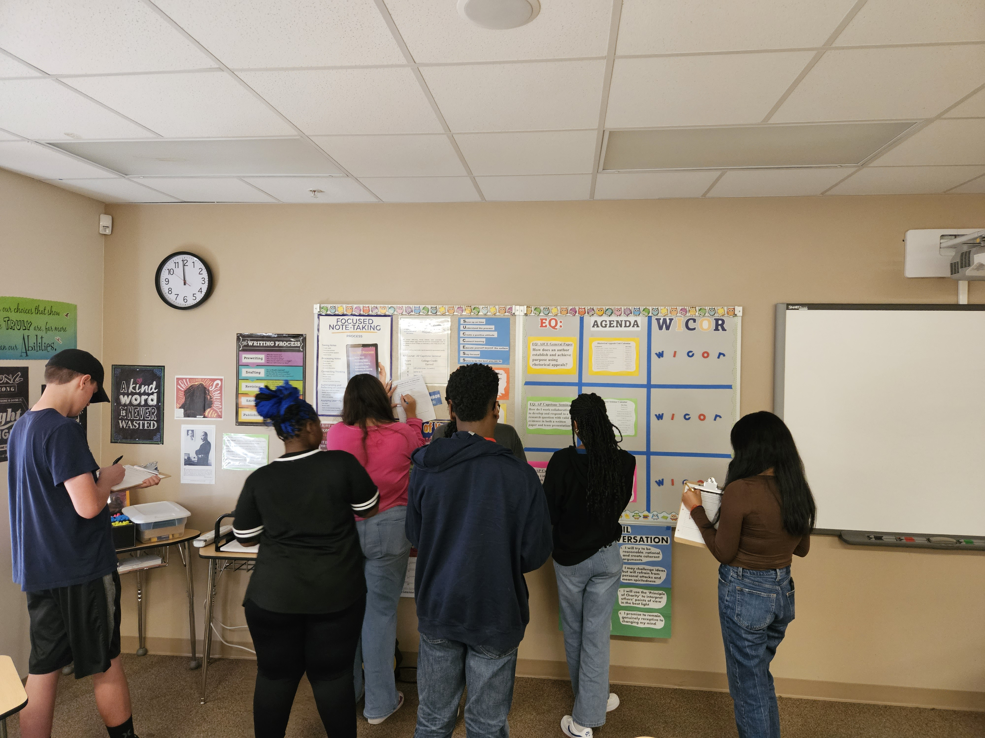
Parent and Family Engagement Plan (PFEP)
ELP – Extended Learning Program
Scholarship Saturdays
AP Test Prep Saturdays

Slide 17
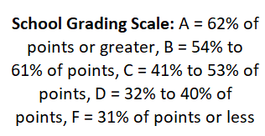

Notes:
Let’s look at our 22-23 results. We were graded this year on a 6-cell formula instead of a 10-cell formula. This is because the State of Florida switched from the FSA to the FAST assessments. As a result, learning gains were not including in the calculation.
Explain the data including Graduation and Acceleration
Here is this guy on his journey much like us reaching for the top.
What do you notice about his path?
Ups and downs.

Slide 18


Florida Benchmark For Excellent Student Thinking Standards (B.E.S.T). You may read more information by visiting, www.fldoe.org.
Notes:
All curriculum, instruction and assessments are based on student-centered expectations.

Slide 19

School’s Curriculum
Florida Benchmark For Excellent Student Thinking Standards (B.E.S.T). form the framework of everything taught at school.
Core Curriculum
  9th and 10th Grade Reading
  English classes
  Math classes
  Science classes
Notes:
This slide is optional if this will be discussed with classroom teacher
School’s Curriculum
Describe and explain the curriculum (Specific names of texts)

Slide 20
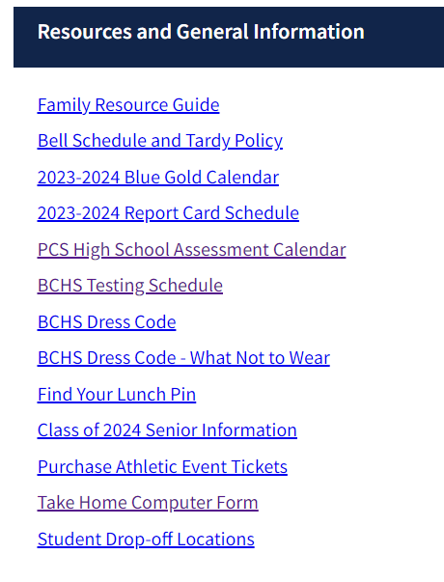
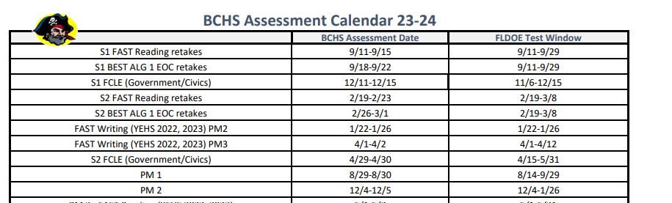
Florida End of Course (EOC)
Assessments
(Algebra 1, Biology, Civics, U.S. History, Geometry)
To learn more about state assessments visit the Florida Department of Education’s website, fldoe.org/accountability/assessments.
Notes:
This slide is only required, if it applies.

Slide 21
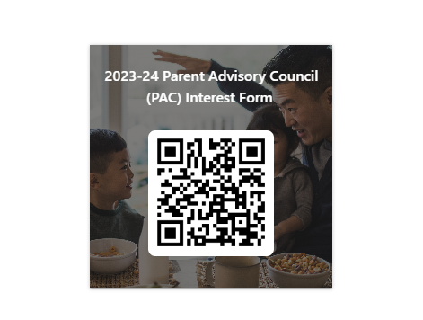

Parent Advisory Council (PAC)
The District has a Parent and Family Engagement Plan. The summary of the plan is in the Title I School & Family Partnership Overview.
You may access the full plan at www.pcsb.org/titleone
The Parent Advisory Council (PAC) is responsible for reviewing and revising the District PFEP.
PAC will meet virtually or in-person with the district’s Title I staff.
Each school is committed to having at least one member representative on PAC.
PAC meets twice a year, if you are interested in representing our school please notify, Insert contact person
Notes:
Please add your PAC representative in slide and share with your Title I Specialist.
https://forms.office.com/r/r5daaMTENE\

Slide 22
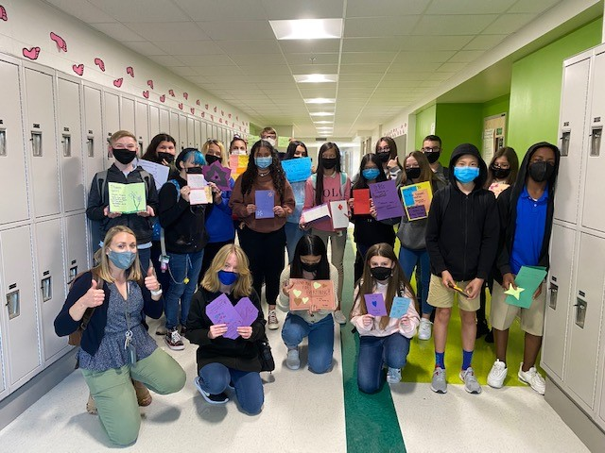

Additional Resources
Learning at Home Family Resources - https://www.pcsb.org/Page/32836
Volunteer in a Pinellas County School - https://www.pcsb.org/Page/459
Parent Academy POWER HOURS Webinars - https://www.pcsb.org/Page/26534
Partnerships - https://www.pcsb.org/Page/418

Slide 23
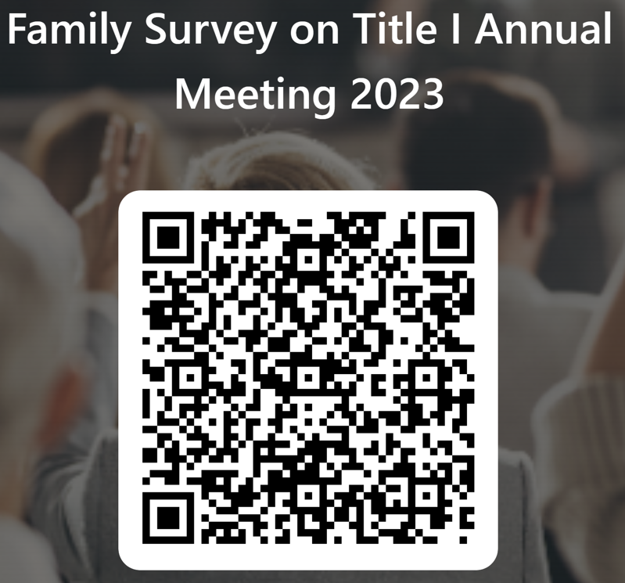
Please take the time to participate in our survey.
Your feedback is greatly appreciated!
Notes:
Please duplicate Microsoft Forms provided or create school survey. To generate a QR code hover over your school’s survey and and right click. Create QR code for this page will be an option.
https://forms.office.com/Pages/ShareFormPage.aspx?id=BZM8c9c5GkaGb_3ye_PH_x-1YNVO6C1FkgA88U6PR2tUNEQzTU0wNkZXVUxVTlpEMU81NkJFMlJNTi4u&sharetoken=FXXhmgwFjSnl0sNz61ki

